Slide 1
Welcoming, Empowering,
Safe Habitation Initiative with
Neighborhood Engagement
https:\\www.weshinepdx.org
A Program of Cascadia Clusters

Slide 2
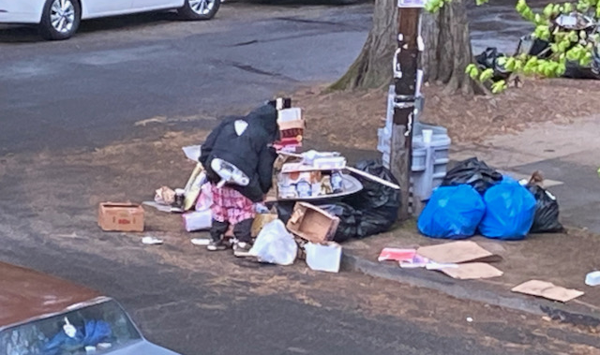
Homeless Outdoor Camping Explodes Beyond Public Agencies’ Ability to Cope
The need for stable housing and services for the homeless has never been greater.
Neighborhoods and faith-based organizations have an important role to play in providing transitional shelter until there is sufficient affordable permanent housing for all people to live in.

Slide 3
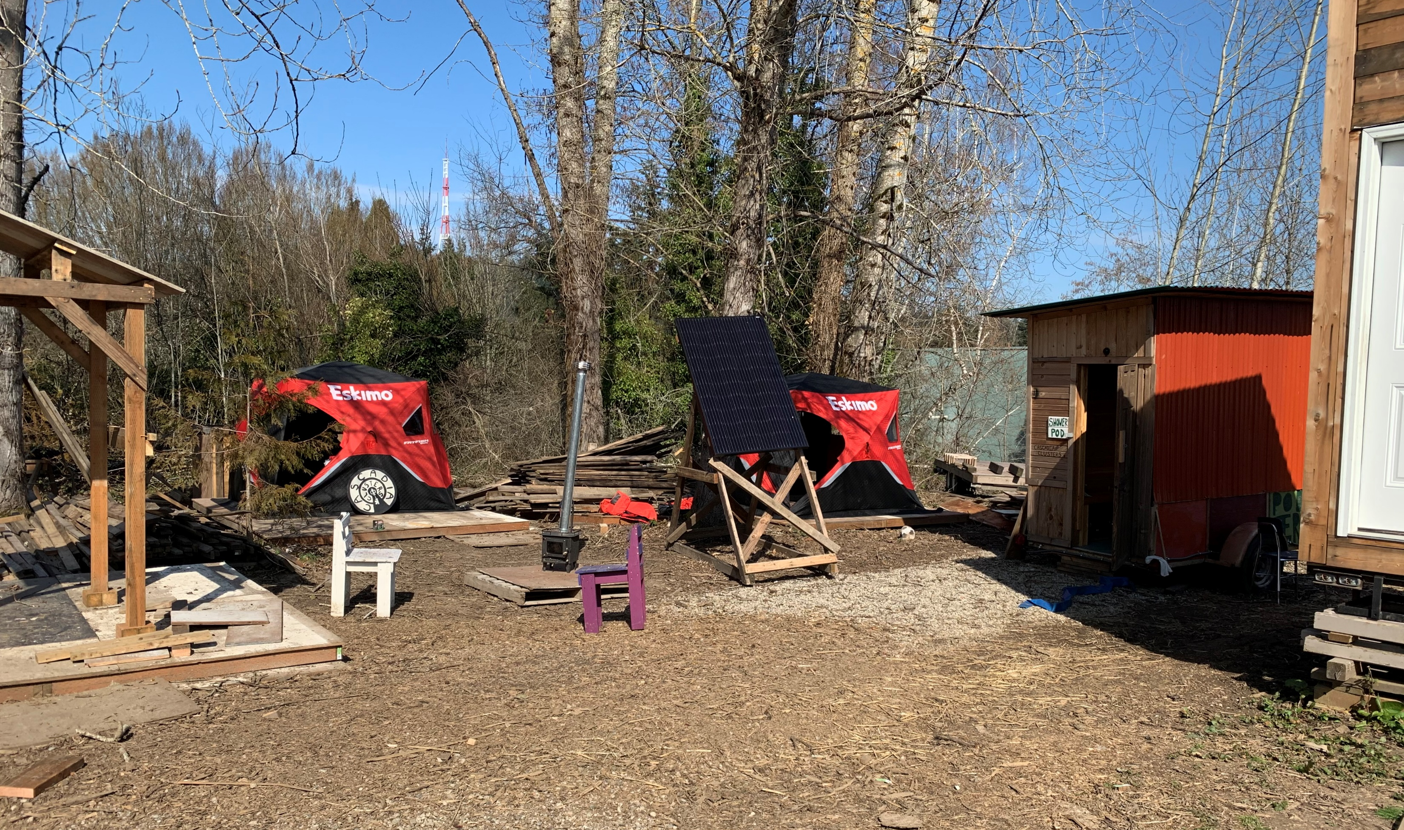
What is a WeShine cluster?
A 6-12 person “managed camping” location on church or other privately-owned property with tents on platforms, tiny houses or parked RVs and cars
Basic hygiene and sanitation services
Community structures for cooking, eating, and meetings
Transitional and supportive services
Seeking locations across the city to avoid overwhelming an area

Slide 4
What Else Does a WeShine Cluster Include?
Fencing for privacy and security
A paid Village Life Coordinator with lived experience of homelessness
Solar powered electricity for lighting, heat, charging phones
Gray water recycling
Container gardens and plantings

Slide 5
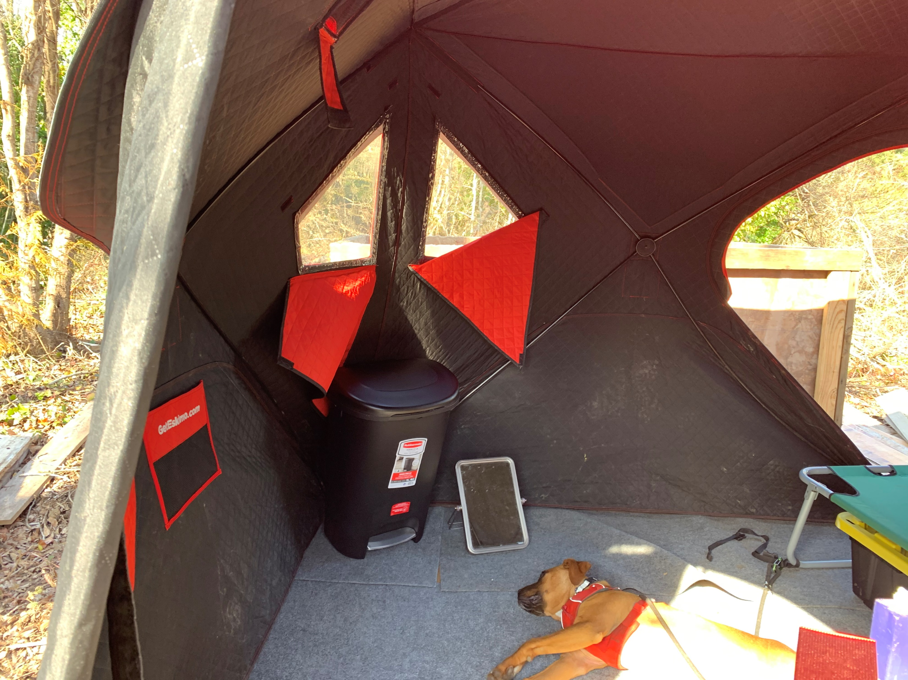
What transitional and supportive services does a WeShine cluster offer?
Volunteer services such as communal meals, recreational and social activities
Opportunities to be engaged with neighbors to improve the community
Peer and outreach service providers to link villagers to housing, health, and other services
A paid, resident “village life coordinator “ with lived experience of homelessness
A Village Council to address community issues and sustain Good Neighbor Agreement

Slide 6
What Kind of Locations is WeShine Looking For?
Parking lot or undeveloped lot
5,000 SF or more
Located near public transit and retail/commercial resources
Access to electricity, sewer, and water on site is preferred

Slide 7
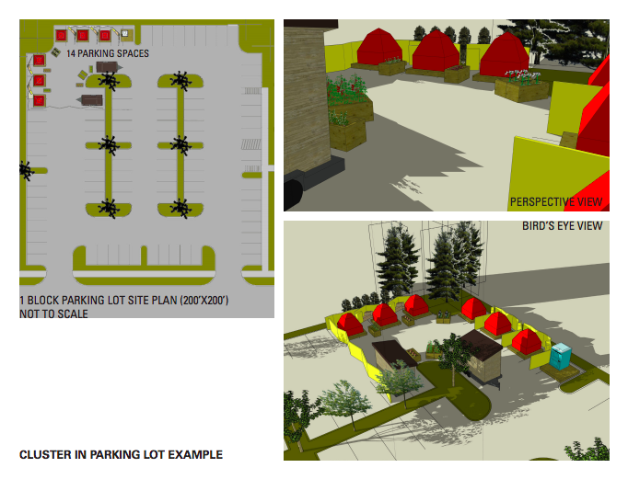
WE SHINE POD - Example

Slide 8
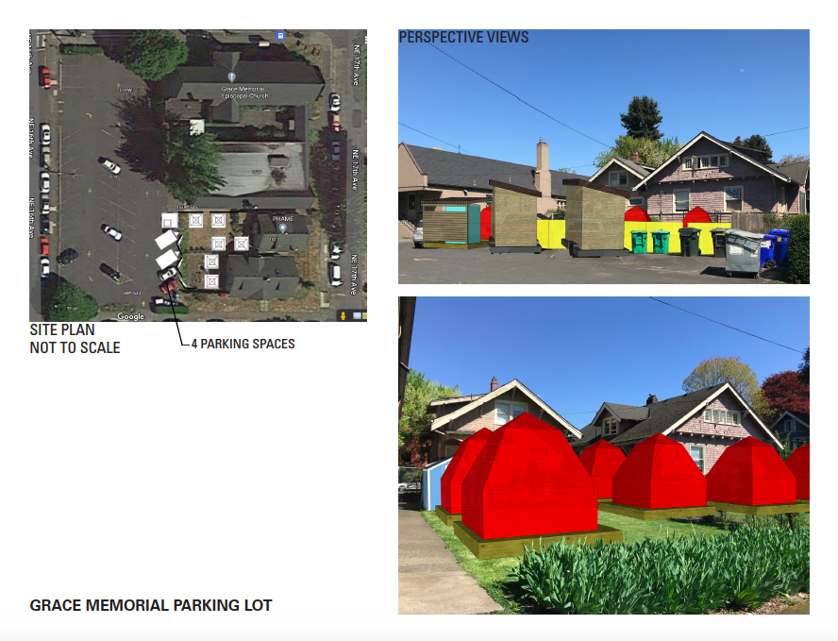
WE SHINE POD - Example

Slide 9

Consider Becoming a WeShine Cluster Sponsor
Cascadia Clusters and WeShine will :
  Build and support the clusters, and help campers transition to permanent housing
  Provide a lease payment and liability insurance to the sponsor
  Develop a Good Neighbor Agreement with neighbors and the property owner that each camper will sign before moving in
  Coordinate community volunteers to support the cluster with services, meals, and social events
The Sponsor will:
Provide a site for at least one cluster of six tents, tiny houses, or parked vehicles
Provide volunteers to support each cluster
Assist Cascadia Clusters and WeShine to raise funds to maintain each cluster
This Photo by Unknown Author is licensed under CC BY-SA

Slide 10
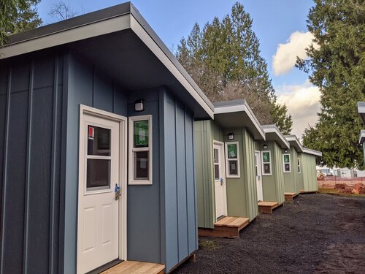
Who pays for the WeShine clusters & services
We expect the cost to develop the first 5 clusters will be covered by the Joint Office of Homeless Services
We are seeking foundation grants to expand and maintain our clusters in additional locations
Cascadia Clusters and WeShine will plan and implement other fund-raising activities and events
Tax deductible donations to Cascadia Clusters/WeShine are welcome

Slide 11
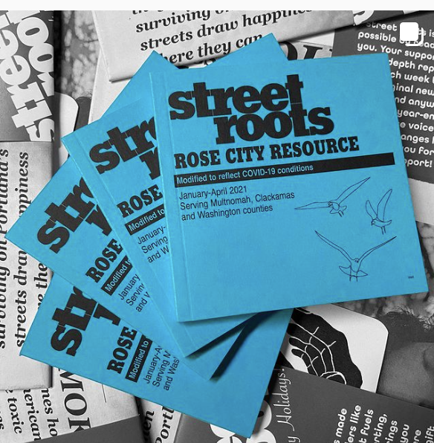
Who’s behind WeShine?
Founded by Janet McManus, LMSW and housing advocate for over 40 years, and Dave Weaver, a Kerns Neighborhood Association Board member and homeless services advocate.
Currently managed informally by a group of volunteers from several NE and SE neighborhoods. Plans are underway to incorporate as a non-profit corporation, to apply for tax exemption and to recruit a diverse Board of Directors.
Operates under the umbrella of Cascadia Clusters, a 501(c)(3) nonprofit organization that builds the tiny houses and platforms and provides training and jobs for the houseless.
Is preparing to launch a sustained outreach effort, guided by Street Roots and other organizations led by persons with lived experience of houselessness, to get to know and engage houseless neighbors in our work.

Slide 12

WeShine is Seeking Potential Board Members and Volunteers
Interested individuals, particularly those with lived experience of houselessness and from the BIPOC and/or LBGTQ+ communities are encouraged to contact us.
Volunteer-led outreach to current encampments to build relationships will be launching soon
Work parties to help build cluster infrastructure will also be scheduled soon
  https:\\www.weshinepdx.org
This Photo by Unknown Author is licensed under CC BY-NC

Slide 13

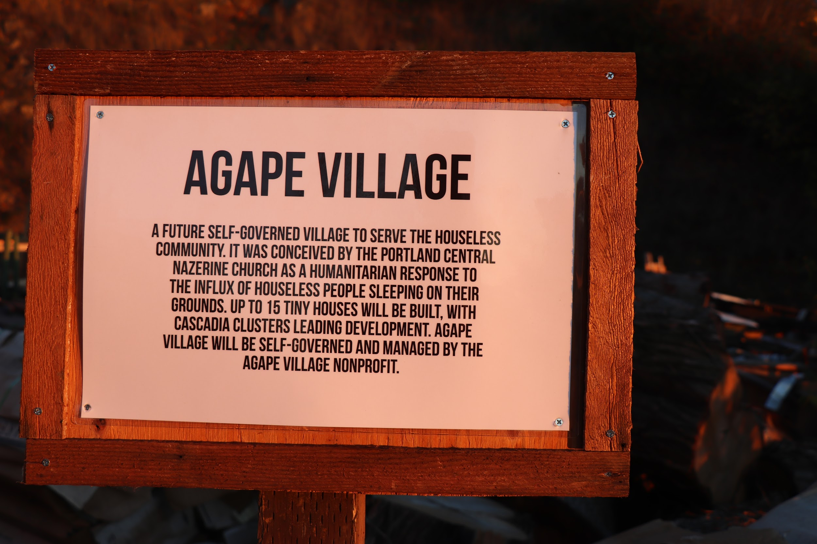
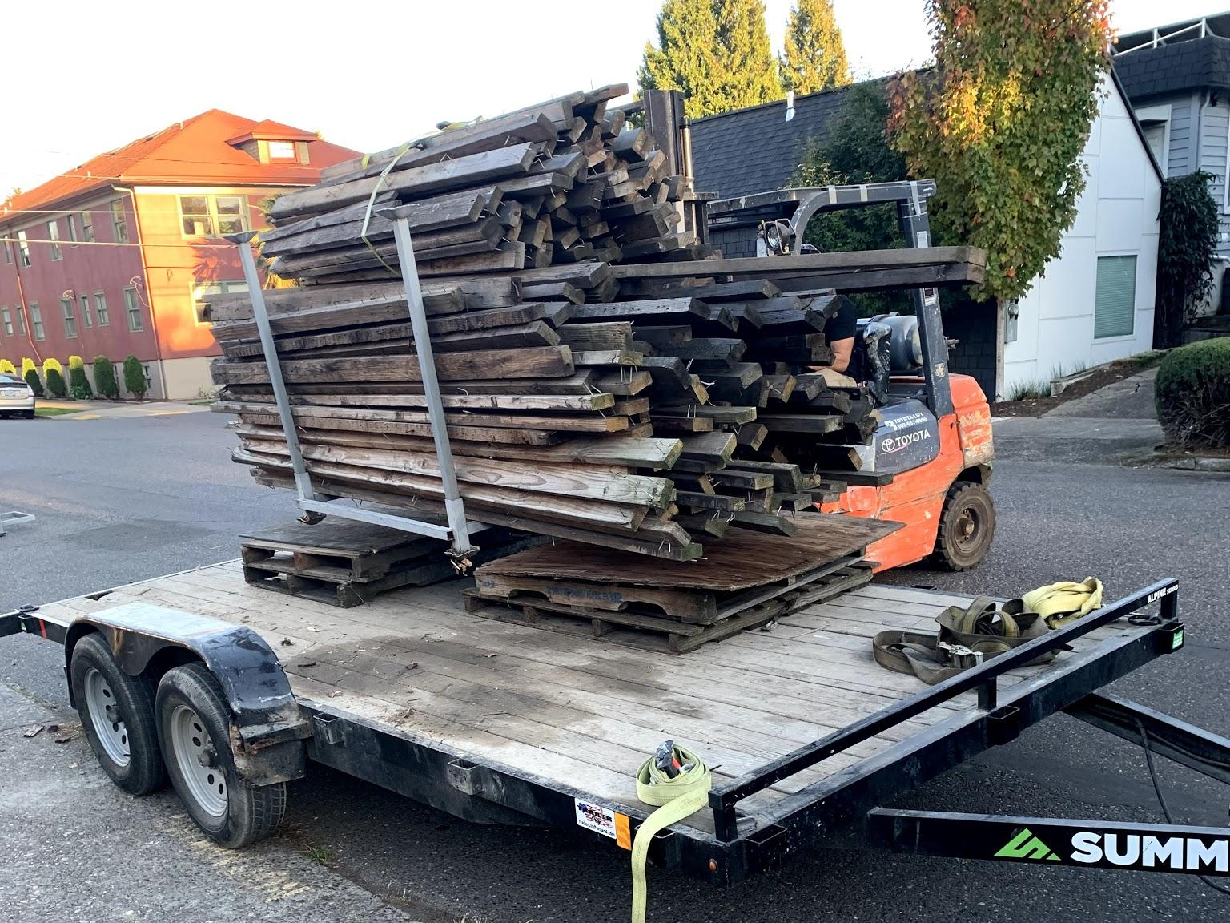
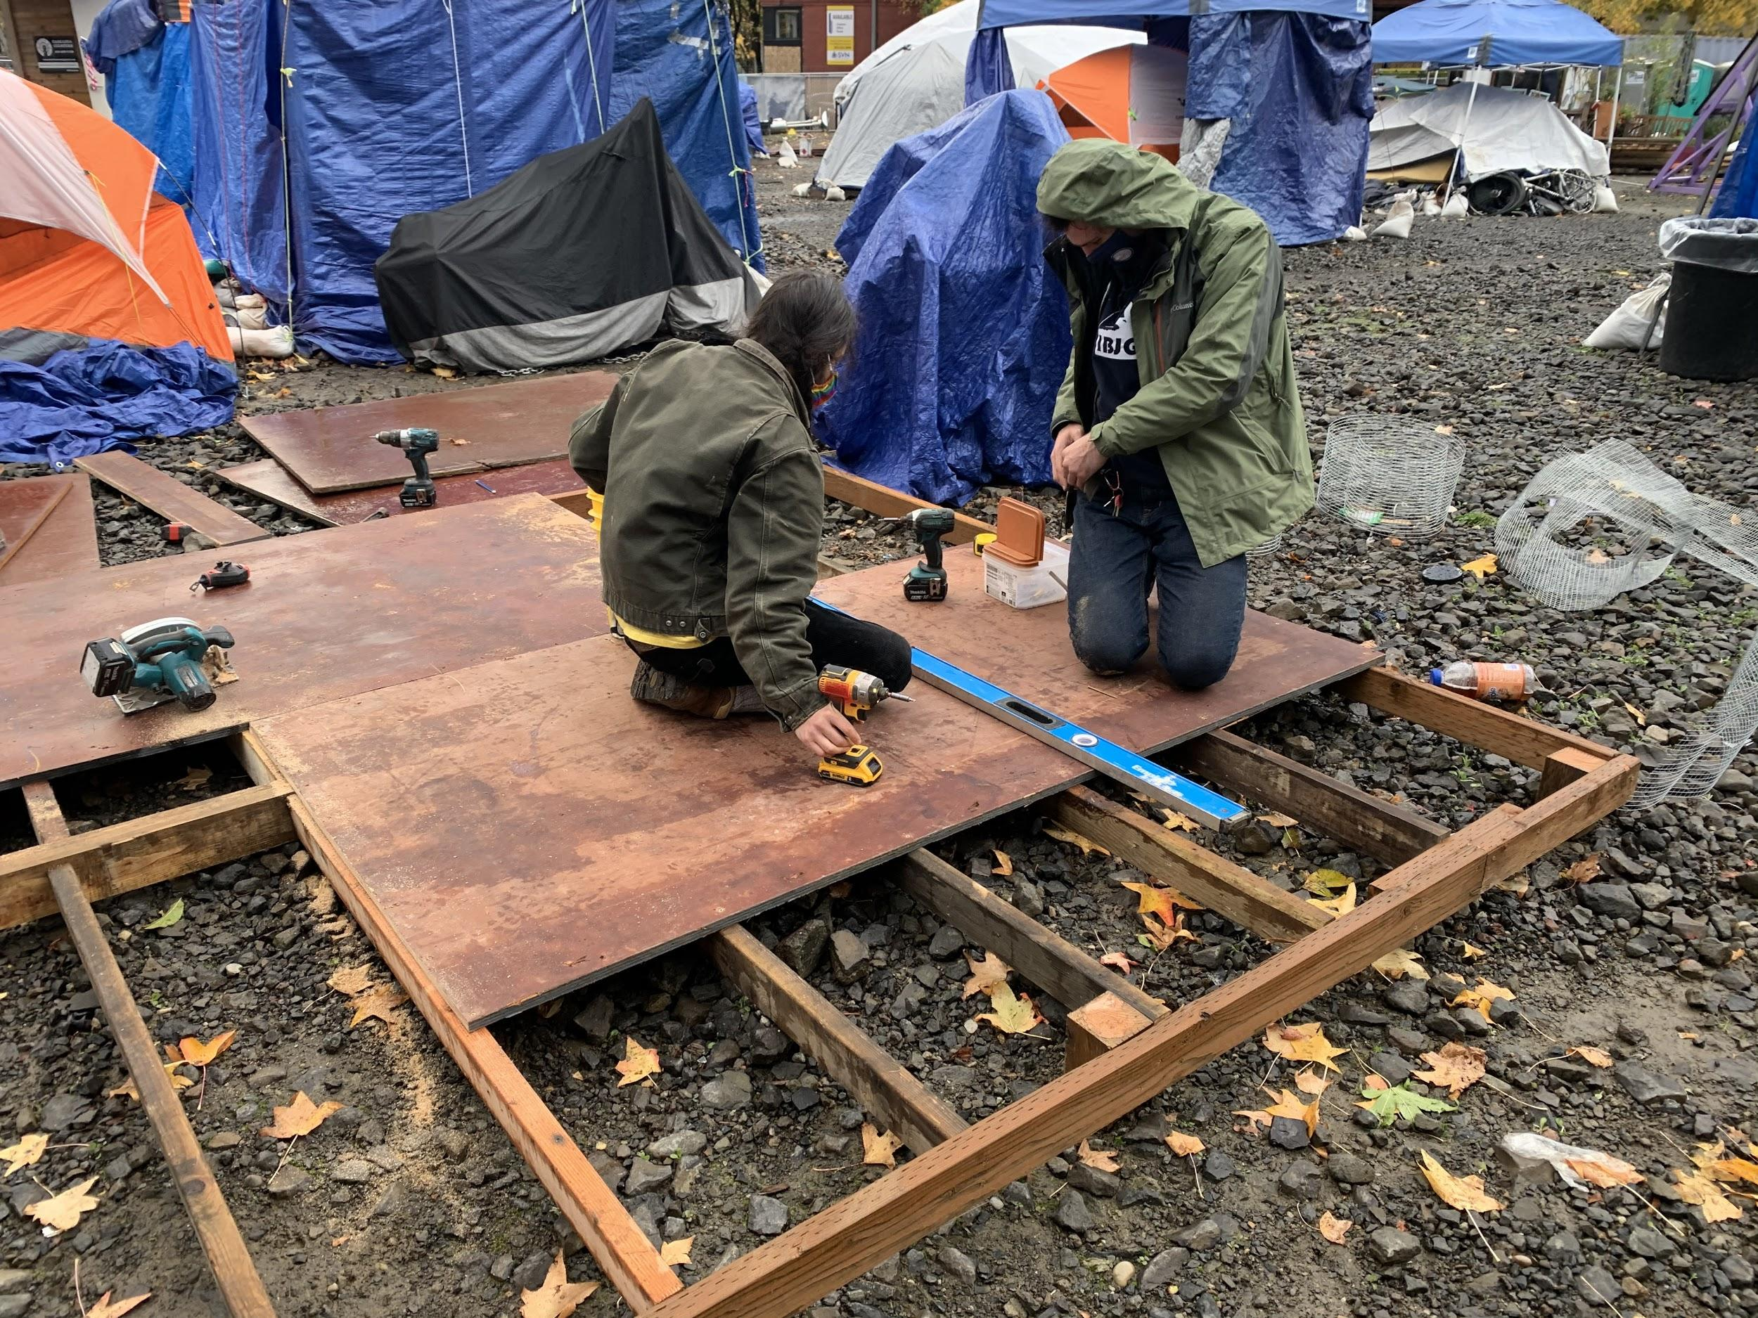
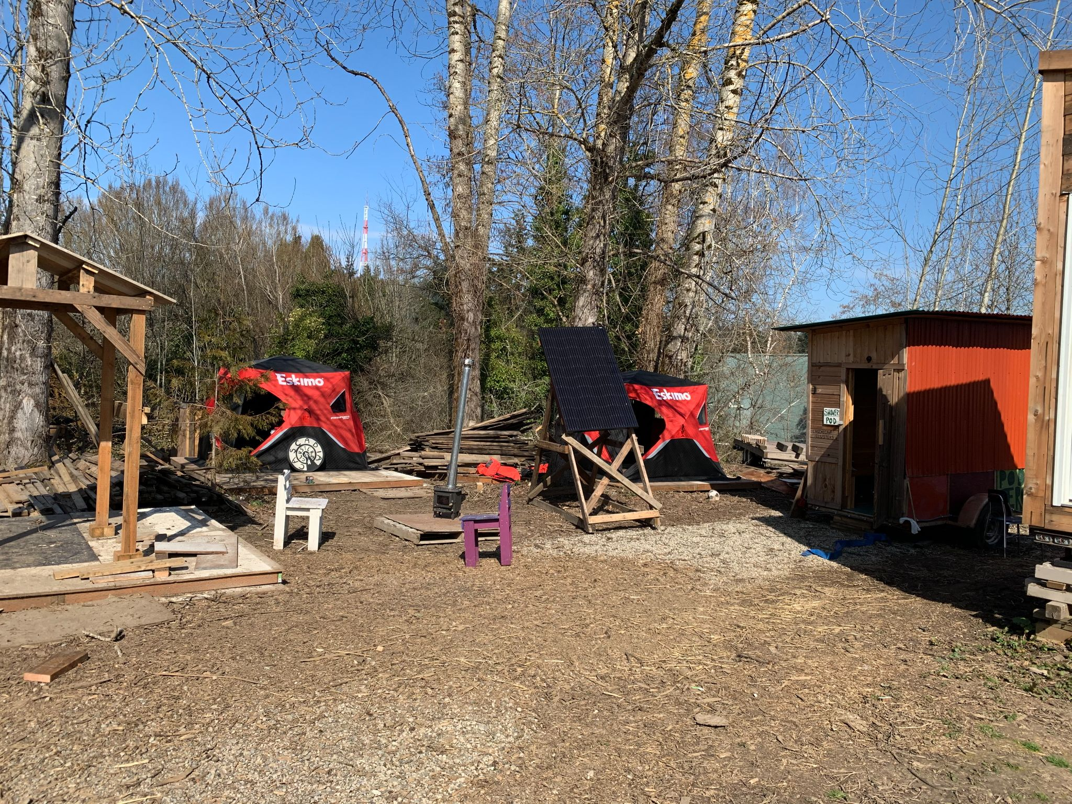
Cascadia
Clusters

Slide 14
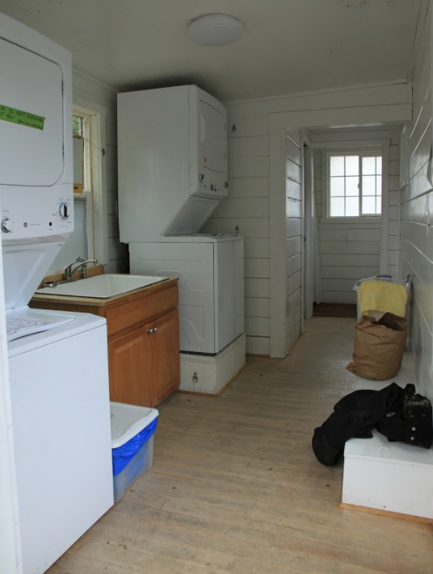
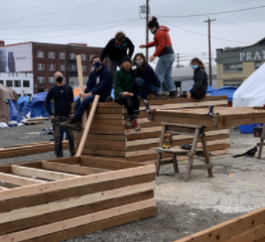
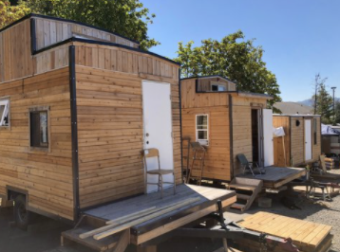
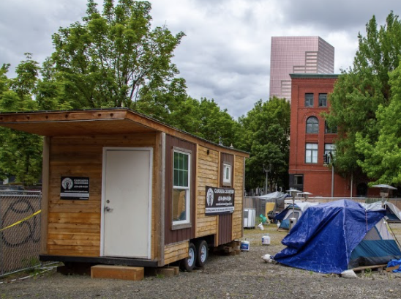
Mission
  Create opportunities for houseless individuals to gain valuable construction skills so they can build infrastructure that addresses service gaps in their own communities.
    Build structures for homeless villages
    Employ houseless individuals in transition
    Engage diverse communities in the solutions

Slide 15
What We Do / Don’t Do
  Do:
  Build structures for homeless villages
  Employ individuals in transition as construction staff to gain skills and agency
  Opportunistic projects to subsidize income
    Youth workshops and “for sale” products(picnic tables, etc)
  Don’t do:
  Wrap-around services
  Operate villages

Slide 16
2020-2021 – An Existential Challenge
  How we’ve navigated COVID-19:
  Scaled back employees
  Build for city sanctioned homeless villages
  Lease/sell hygiene stations
  Youth workshops
  Sell constructed items (eg picnic tables)
  Solicit individual and foundation contributions

Slide 17
Approach for 2021 -2022
  We will :
  Focus on building structures for homeless camps using labor from people in transition.
  Seek partner(s) for neighborhood engagement, siting, wrap around services, etc.
  Supplement funding to keep staff employed, offer youth workshops, build “for sale” products (e.g. picnic tables)
  Engage folks where they are through neighborhood initiatives (Bertha model)
  Expand Funding:
  Submit proposals for building camps sanctioned/funded by local authorities
  Charitable solicitation (foundations, individuals)
  Opportunistic projects to subsidize income

